Slide 1
CSS (Cascading Style Sheets)
by
Sona College Of Technology

Slide 2
Introduction
CSS stands for Cascading Style Sheets.
CSS describes how HTML elements are to be displayed on screen, paper, or in other media.
CSS saves a lot of work. It can control the layout of multiple web pages all at once.
External style sheets are stored in CSS files

Slide 3
Example:
<!DOCTYPE>
<html>
<head>
<style>
h1{
color: white;
background-color: red;
adding:5px;
}
p{
color: blue;
}
</style>
</head>
</html>

Slide 4
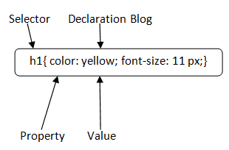
Syntax
A CSS rule set contains a selector and a declaration block.

Slide 5
SELECTOR:
Selector indicates the HTML element you want to style. It could be any tag like <h1>, <title> etc.
Selector{Property1: value1; Property2: value2; ..........;}
DECLARATION BLOCK:
The declaration block can contain one or more declarations separated by a semicolon. For the above example, there are two declarations:
color: yellow;
font-size: 11 px;
Each declaration contains a property name and value, separated by a colon.
PROPERTY:
A Property is a type of attribute of HTML element. It could be color, border etc.
VALUE:
Values are assigned to CSS properties. In the above example, value "yellow" is assigned to color property.

Slide 6
CSS Selector
CSS selectors are used to select the content you want to style. Selectors are the part of CSS rule set. CSS selectors select HTML elements according to its id, class, type, attribute etc.
There are several different types of selectors in CSS:-
CSS Element Selector
CSS Id Selector
CSS Class Selector
CSS Universal Selector
CSS Group Selector

Slide 7
CSS ELEMENT SELECTOR
The element selector selects HTML elements based on the element name.
Example:
<style>
p{
text-align: center;
color: blue;
}
</style>
</head>
<body>
<p>This style will be applied on every paragraph.</p>
<p id="para1">Me too!</p>
<p>And me!</p>
</body>
</html>

Slide 8
CSS id Selector
The id selector uses the id attribute of an HTML element to select a specific element.
The id of an element is unique within a page, so the id selector is used to select one unique element!
To select an element with a specific id, write a hash (#) character, followed by the id of the element.
EXAMPLE: <style>
#para1 {
text-align: center;
color: blue;
}
</style>
</head>
<body>
<p id="para1">Hello Welcome</p>
<p>This paragraph will not be affected.</p>
</body>
</html>

Slide 9
CSS class Selector
The class selector selects HTML elements with a specific class attribute.
To select elements with a specific class, write a period (.) character, followed by the class name.
Example:
<html>
<style>
p.center {
text-align: center;
color: blue;
}
</style>
</head>
<body>
<h1 class="center">This heading is blue and center-aligned.</h1>
<p class="center">This paragraph is blue and center-aligned.</p>
</body>
</html>
In this example all HTML elements with class="center" will be red and center-aligned.

Slide 10
Universal Selector
The universal selector (*) selects all HTML elements on the page.
Example
<style>
* {
text-align: center;
color: blue;
}
</style>
<body>
<h2>This is heading</h2>
<p>This style will be applied on every paragraph.</p>
<p id="para1">Me too!</p>
<p>And me!</p>
</body>
</html>

Slide 11
Grouping Selector
The grouping selector selects all the HTML elements with the same style definitions.
It will be better to group the selectors, to minimize the code.
To group selectors, separate each selector with a comma. EXAMPLE:
<html>
<head>
<style>
h1, h2, p {
text-align: center;
color: blue;
}
</style>
</head>
<body>
<h1>Hello Welcome</h1>
<h2>This is home page (In smaller font)</h2>
<p>This is a paragraph.</p>
</body>
</html>

Slide 12
HOW TO ADD CSS:
CSS is added to HTML pages to format the document according to information in the style sheet. There are three ways to insert CSS in HTML documents.
Inline CSS
Internal CSS
External CSS
1) Inline CSS
Inline CSS is used to apply CSS on a single line or element.
For example:
<p style="color:blue">Hello CSS</p>
2) Internal CSS
Internal CSS is used to apply CSS on a single document or page. It can affect all the elements of the page. It is written inside the style tag within head section of html.
For example:
<style>
p{color:blue}
</style>

Slide 13
3) External CSS
External CSS is used to apply CSS on multiple pages or all pages. Here, we write all the CSS code in a css file. Its extension must be .css for example style.css.
For example:
p{
color: blue
}
You need to link this style.css file to your html pages like this:
<link rel="stylesheet" type="text/css" href="style.css">

Slide 14
Inline CSS
We can apply CSS in a single element by inline CSS technique.
The inline CSS is also a method to insert style sheets in HTML document.
If you want to use inline CSS, you should use the style attribute to the relevant tag.
Syntax:
<htmltag style="cssproperty1:value; cssproperty2:value;"> </htmltag>
Example:
<h2 style="color:red;margin-left:40px;">Inline CSS is applied on this heading.</h2>
<p>This paragraph is not affected.</p>
Output:
Inline CSS is applied on this heading.
This paragraph is not affected.

Slide 15
Internal CSS
The internal style sheet is used to add a unique style for a single document. It is defined in <head> section of the HTML page inside the <style> tag.
Example:
<html>
<head>
<style>
body {
background-color: linen;
}
h1 {
color: red;
margin-left: 80px;
}
</style>
</head>
<body>
<h1>The internal style sheet is applied on this heading.</h1>
</body>
</html>

Slide 16
External CSS
The external style sheet is generally used when you want to make changes on multiple pages. It is ideal for this condition because it facilitates you to change the look of the entire web site by changing just one file.
It uses the <link> tag on every pages and the <link> tag should be put inside the head section.
<head>
<link rel="stylesheet" type="text/css" href="mystyle.css">
</head>
The external style sheet may be written in any text editor but must be saved with a .css extension. This file should not contain HTML elements.
Let's take an example of a style sheet file named "mystyle.css".
File: mystyle.css
body {
background-color: blue;
}
h1 {
color: navy;
margin-left: 20px;
}

Slide 17
Comments
Comments are used to explain the code, and may help when you edit the source code at a later date.
Comments are ignored by browsers.
A CSS comment is placed inside the <style> element, and starts with /* and ends with */:

Slide 18
CSS Properties
CSS Background
CSS background property is used to define the background effects on element.
background-color
background-image
background-repeat
background-attachment
background-position
1) CSS background-color
The background-color property is used to specify the background color of the element.
<style>
h2,p{
background-color: #b0d4de;
}
</style>
<body>
<h2>My first CSS page.</h2>
<p>Hello ! This is an example of CSS background-color.</p>
</body>
</html>

Slide 19
CSS background-image
The background-image property is used to set an image as a background of an element. By default the image covers the entire element. You can set the background image for a page like this.
EXAMPLE:
<html>
<head>
<style>
body {
background-image: url("paper1.gif");
margin-left:100px;
}
</style>
</head>
<body>
<h1>Hello welcome</h1>
</body>
</html>

Slide 20
CSS background-repeat
By default, the background-image property repeats the background image horizontally and vertically. Some images are repeated only horizontally or vertically.
The background looks better if the image repeated horizontally only.
background-repeat: repeat-x;
EXAMPLE:
<style>
body {
background-image: url("gradient_bg.png");
background-repeat: repeat-x;
}

Slide 21
CSS background-attachment:
The background-attachment property is used to specify if the background image is fixed or scroll with the rest of the page in browser window. If you set fixed the background image then the image will not move during scrolling in the browser.
background: white url('bbb.gif');
background-repeat: no-repeat;
background-attachment: fixed;
CSS background-position:
The background-position property is used to define the initial position of the background image. By default, the background image is placed on the top-left of the webpage.
center
top
bottom
left
right
background: white url('good-morning.jpg');
background-repeat: no-repeat;
background-attachment: fixed;
background-position: center;

Slide 22
CSS Border
The CSS border is a shorthand property used to set the border on an element.
The CSS border properties are use to specify the style, color and size of the border of an element.
border-style
border-color
border-width
border-radius
EXAMPLE:
<style>
p.none {border-style: none;}
p.dotted {border-style: dotted;}
p.dashed {border-style: dashed;}
p.solid {border-style: solid;}
p.double {border-style: double;}
p.groove {border-style: groove;}
p.ridge {border-style: ridge;}
p.inset {border-style: inset;}
p.outset {border-style: outset;}
p.hidden {border-style: hidden;}
</style>

Slide 23
1) CSS border-style
The Border style property is used to specify the border type which you want to display on the web page.
Value | Description
none | It doesn't define any border.
dotted | It is used to define a dotted border.
dashed | It is used to define a dashed border.
solid | It is used to define a solid border.
double | It defines two borders wIth the same border-width value.
groove | It defines a 3d grooved border. effect is generated according to border-color value.
ridge | It defines a 3d ridged border. effect is generated according to border-color value.
inset | It defines a 3d inset border. effect is generated according to border-color value.
outset | It defines a 3d outset border. effect is generated according to border-color value.

Slide 24
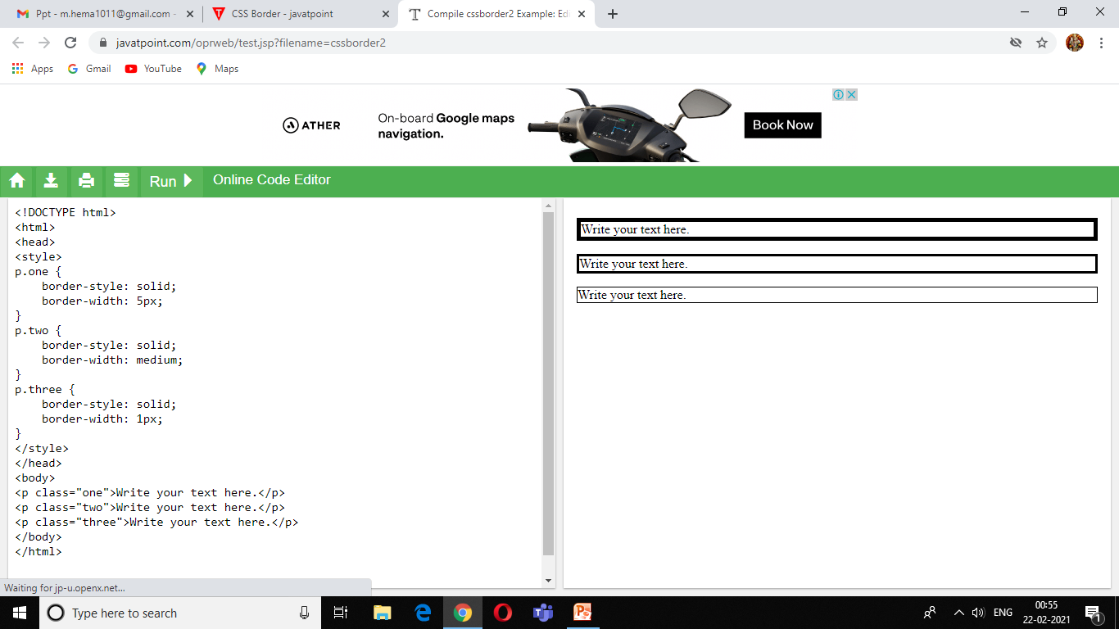
CSS border-width
The border-width property is used to set the border's width. It is set in pixels. You can also use the one of the three pre-defined values, thin, medium or thick to set the width of the border.

Slide 25
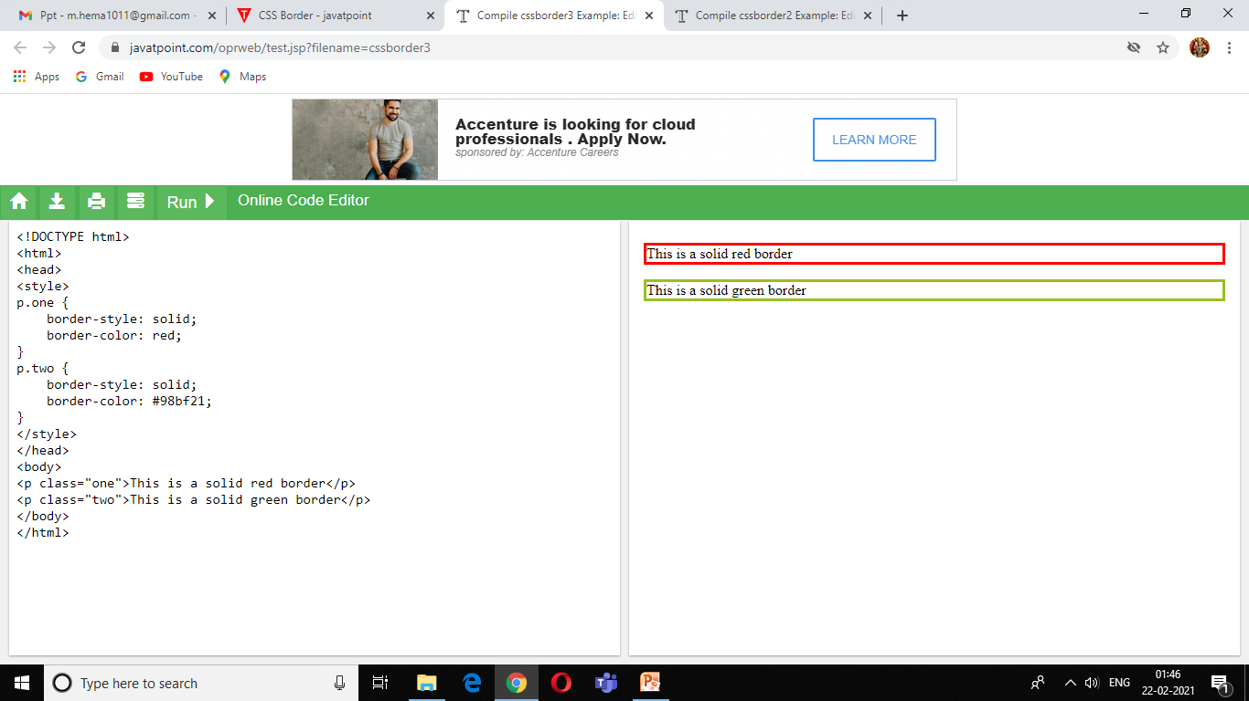
3) CSS border-color
There are three methods to set the color of the border.
Name: It specifies the color name. For example: "red".
RGB: It specifies the RGB value of the color. For example: "rgb(255,0,0)".
Hex: It specifies the hex value of the color. For example: "#ff0000".

Slide 26
CSS border-radius property
This CSS property sets the rounded borders and provides the rounded corners around an element, tags, or div. It defines the radius of the corners of an element.
It is shorthand for border top-left-radius, border-top-right-radius, border-bottom-right-radius and border-bottom-left-radius.
<style>
<head>
<p>border-radius: 50px 50% 50cm 50em;</p>
Property | Description
border-top-left-radius | It is used to set the border-radius for the top-left corner
border-top-right-radius | It is used to set the border-radius for the top-right corner
border-bottom-right-radius | It is used to set the border-radius for the bottom-right corner
border-bottom-left-radius | It is used to set the border-radius for the bottom-left corner

Slide 27
CSS border-collapse property
This CSS property is used to set the border of the table cells and specifies whether the table cells share the separate or common border.
This property has two main values that are separate and collapse. When it is set to the value separate, the distance between the cells can be defined using the border-spacing property. When the border-collapse is set to the value collapse, then the inset value of border-style property behaves like groove, and the outset value behaves like ridge.
Syntax:-
border-collapse: separate | collapse | initial | inherit;
Linkhttps://www.javatpoint.com/oprweb/test.jsp?filename=css-border-collapse-property2

Slide 28
Other CSS display values
Property-value | Description
flex | It is used to display an element as an block-level flex container. It is new in css3.
inline-flex | It is used to display an element as an inline-level flex container. It is new in css3.
inline-table | It displays an element as an inline-level table.
list-Item | It makes the element behave like a <li> element.
table | It makes the element behave like a <table> element.
table-caption | It makes the element behave like a <caption> element.
table-column-group | It makes the element behave like a <colgroup> element.
table-header-group | It makes the element behave like a <thead> element.
table-footer-group | It makes the element behave like a <tfoot> element.
table-row-group | It makes the element behave like a <tbody> element.
table-cell | It makes the element behave like a <td> element.
table-row | It makes the element behave like a <tr> element.
table-column | It makes the element behave like a <col> element.

Slide 29
CSS Font
CSS Font property is used to control the look of texts. By the use of CSS font property you can change the text size, color, style and more. You have already studied how to make text bold or underlined.
CSS Font color: This property is used to change the color of the text. (standalone attribute)
<style>
body {
font-size: 100%;
}
h1 { color: red; }
h2 { color: #9000A1; }
p { color:rgb(0, 220, 98); }
}
</style>
CSS Font family: This property is used to change the face of the font.
<style>
body {
font-size: 100%;
}
h1 { font-family: sans-serif; }
h2 { font-family: serif; }
p { font-family: monospace; }
}
</style>

Slide 30
CSS Font size: This property is used to increase or decrease the size of the font.
CSS Font style: This property is used to make the font bold, italic or oblique.
<style>
body {
font-size: 100%;
}
h2 { font-style: italic; }
h3 { font-style: oblique; }
h4 { font-style: normal; }
}
</style>
CSS Font variant: This property creates a small-caps effect.
<style>
p { font-variant: small-caps; }
h3 { font-variant: normal; }
</style>
CSS Font weight: This property is used to increase or decrease the boldness and lightness of the font.

Slide 31
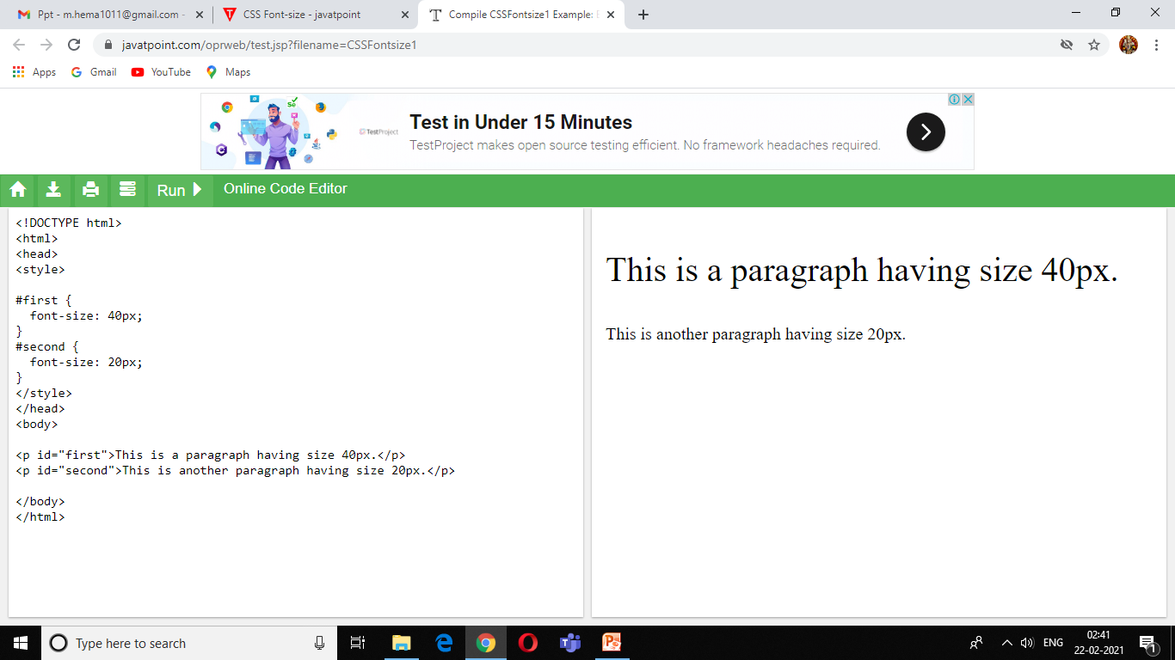
CSS Font-size:-
The font-size property in CSS is used to specify the height and size of the font. It affects the size of the text of an element. Its default value is medium and can be applied to every element. The values of this property include xx-small, small, x-small, etc.
Syntax
font-size: medium|large|x-large|xx-large|xx-small|x-small|small|;
The font-size can be relative or absolute.
Absolute-size:-
It is used to set the text to a definite size. Using absolute-size, it is not possible to change the size of the text in all browsers. It is advantageous when we know the physical size of the output.

Slide 32
CSS COLORS: color: color-name;
S.no. | Color name | Hexadecimal Value | Decimal Value or rgb() value
1. | Red | #FF0000 | rgb(255,0,0)
2. | Orange | #FFA500 | rgb(255,165,0)
3. | Yellow | #FFFF00 | rgb(255,255,0)
4. | Pink | #FFC0CB | rgb(255,192,203)
5. | Green | #008000 | rgb(0,128,0)
6. | Violet | #EE82EE | rgb(238,130,238)
7. | Blue | #0000FF | rgb(0,0,255)
8. | Aqua | #00FFFF | rgb(0,255,255)
9. | Brown | #A52A2A | rgb(165,42,42)
10. | White | #FFFFFF | rgb(255,255,255)
11. | Gray | #808080 | rgb(128,128,128)
12. | Black | #000000 | rgb(0,0,0)

Slide 33
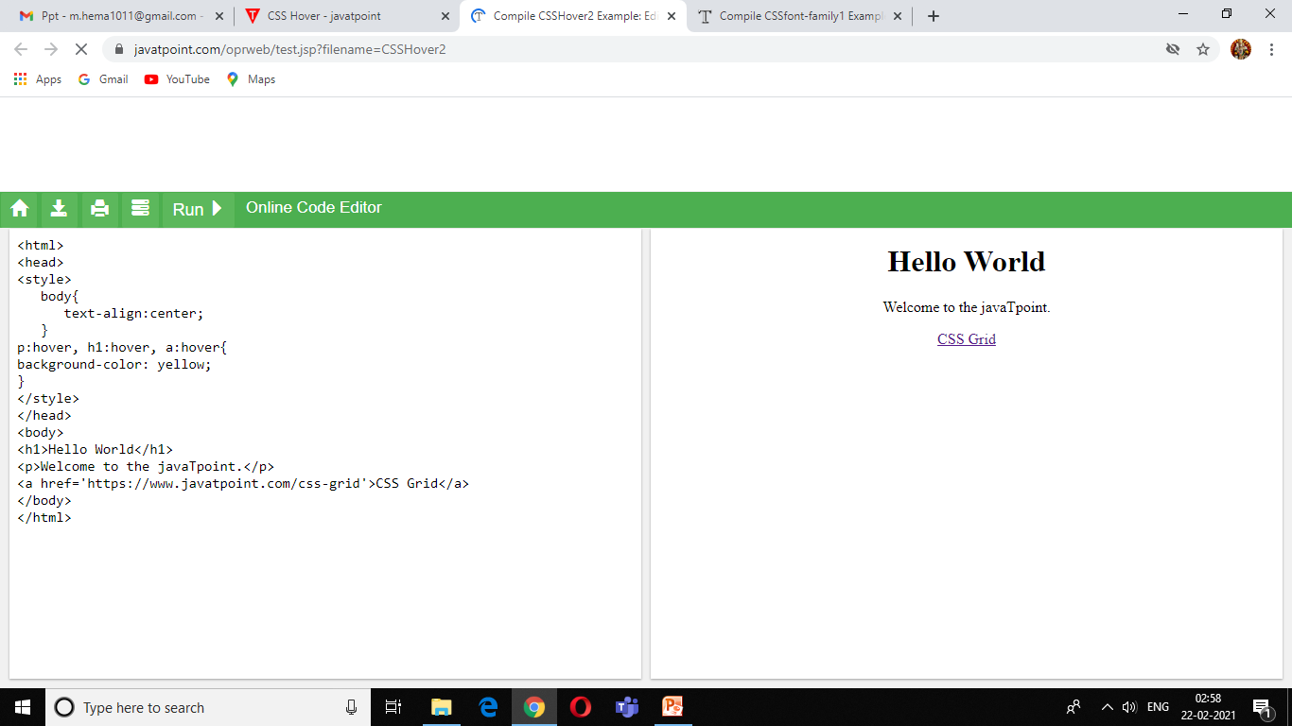
CSS hover
The :hover selector is for selecting the elements when we move the mouse on them. It is not only limited to the links. We can use it on almost every HTML element. To style the link to unvisited pages, we can use the :link selector. To style the link for visited pages, we can use the :visited selector and to style the active links we can use the :active selector.
Change the color of the background and font.
Modify the opacity of the image.
Text embedding.
Create image rollover effects.
Swapping of images.
Syntax
:hover {
css declarations;
}

Slide 34
CSS Background-color
This property is used to set the background color of an element. The background of an element covers the total size, including the padding and border and excluding margin. Syntax
element {
background-color: color_name|transparent|initial|inherit;
}
color_name: It is used for defining the background color value or the color codes. It can be given by using the color name, hexadecimal value, or rgb() value.
transparent: It is the default value of this property, which is used to specify the transparent background-color.
initial: It is not used to set the background color. It sets the default value.
Inherit: It is used to inherit the background-color from its parent.

Slide 35
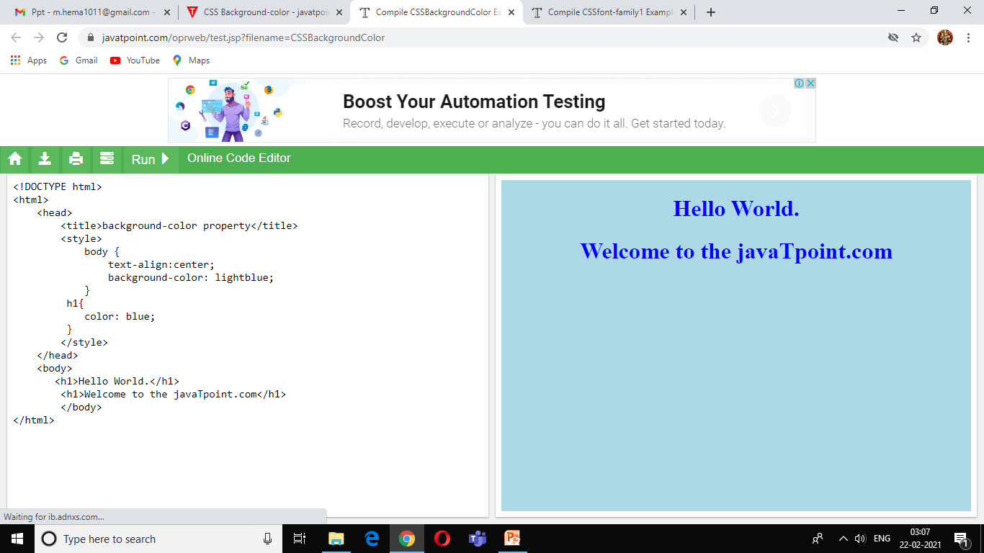

Slide 36
CSS background-attachment property
The background-attachment property is used to specify that the background image is fixed or scroll with the rest of the page in the browser window.
This property has three values scroll, fixed, and local. Its default value is scroll, which causes the element to not scroll with its content. The local value of this property causes the element to scroll with the content. If we set the value to fixed, the background image will not move during scrolling in the browser.
This CSS property can support multiple background images. We can specify a different value of the background-attachment property for each background-image, separated by commas. Every image will match with the corresponding value of this property.
Syntax
background-attachment: scroll | fixed | local | initial | inherit;

Slide 37
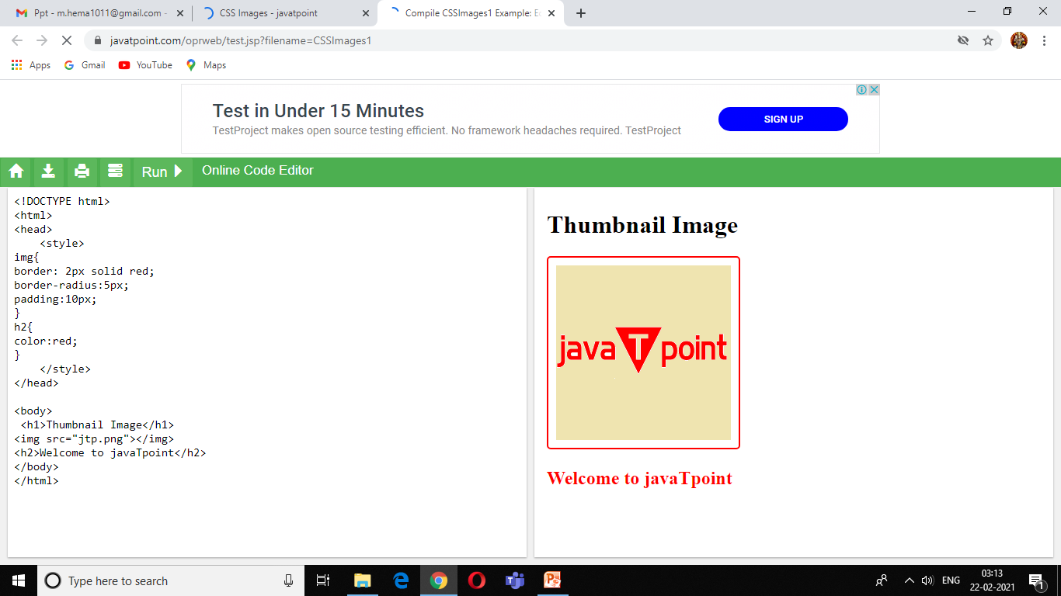
CSS IMAGE

Slide 38
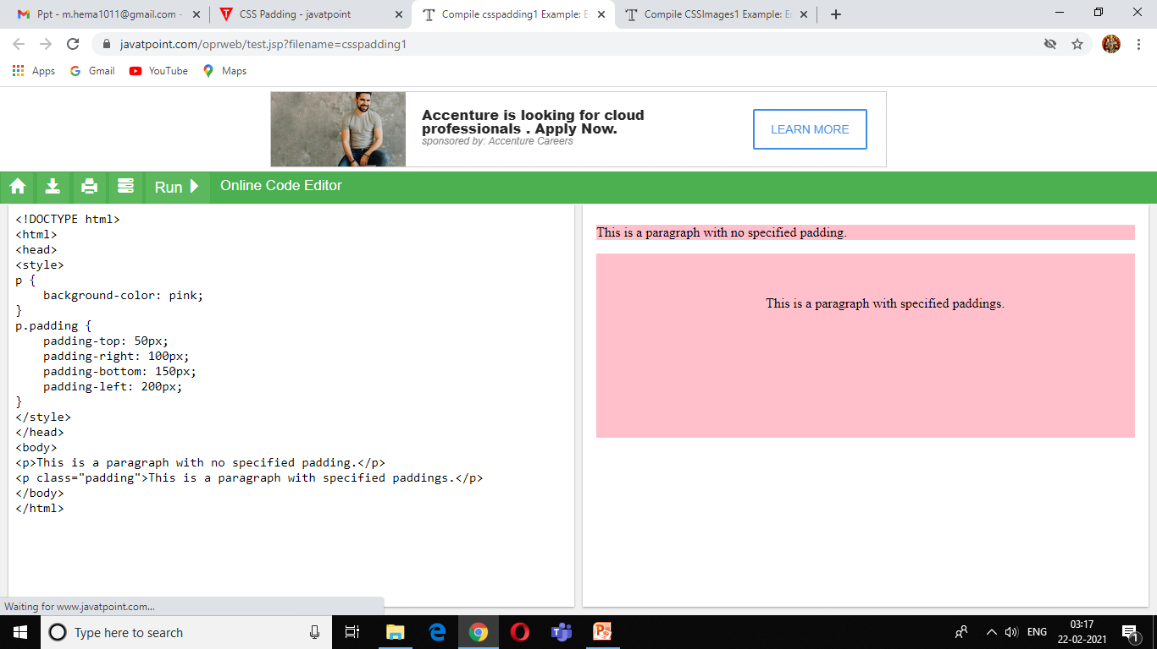
CSS Padding
CSS Padding property is used to define the space between the element content and the element border.
It is different from CSS margin in the way that CSS margin defines the space around elements. CSS padding is affected by the background colors. It clears an area around the content.
Top, bottom, left and right padding can be changed independently using separate properties. You can also change all properties at once by using shorthand padding property.

Slide 39
CSS checkbox style
The checkbox is an HTML element used to take input from the user. It is hard to style the checkbox, but pseudo-elements makes it easier to style a checkbox.
This HTML element is generally used on every website, but without styling them, they look similar on every website. So, styling them will make our site different and attractive. We have to hide the original checkbox in order to style the checkbox. Styling the checkboxes using CSS is an interesting and creative task, which will provide a new and attractive look to the default checkbox.
Link
https://www.javatpoint.com/oprweb/test.jsp?filename=CSScheckboxstyle2

Slide 40
CSS Navigation bar
A Navigation bar or navigation system comes under GUI that helps the visitors in accessing information. It is the UI element on a webpage that includes links for the other sections of the website.
A navigation bar is mostly displayed on the top of the page in the form of a horizontal list of links. It can be placed below the logo or the header, but it should always be placed before the main content of the webpage.
It is important for a website to have easy-to-use navigation. It plays an important role in the website as it allows the visitors to visit any section quickly.
Link
https://www.javatpoint.com/oprweb/test.jsp?filename=CSSNavigationbar5

Slide 41
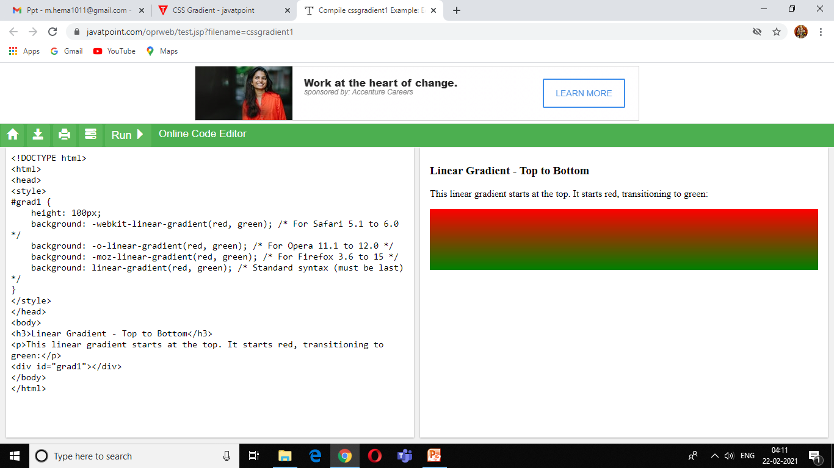
CSS Gradient
There are two types of gradient in CSS3.
Linear gradients
Radial gradients
background: linear-gradient (direction, color-stop1, color-stop2.....);

Slide 42
Pseudo-classes
A pseudo-class is used to define a special state of an element.
Syntax:
selector:pseudo-class
{ property: value; }

Slide 43
Pseudo-Elements
A CSS pseudo-element is used to style specified parts of an element.
Syntax:
selector::pseudo-element
{ property: value; }

Slide 44
The ::first-line Pseudo-element
The ::first-line pseudo-element is used to add a special style to the first line of a text.
The following properties apply to the ::first-line pseudo-element:
font properties
color properties
background properties
word-spacing
letter-spacing
text-decoration
vertical-align
text-transform
line-height
clear

Slide 45
The ::before Pseudo-element
The ::before pseudo-element can be used to insert some content before the content of an element.
The ::after Pseudo-element
The ::after pseudo-element can be used to insert some content after the content of an element.
The ::marker Pseudo-element
The ::marker pseudo-element selects the markers of list items.
The ::selection Pseudo-element

Slide 46
Thank You

